Slide 1
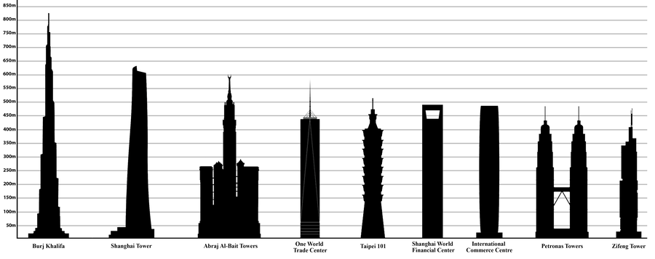

The 5 Current Tallest Buildings Of The World 2022

Slide 2
The World’s Tallest Buildings 2022
In recent years, there has been a trend between countries of the world, competing in constructing the ‘worlds tallest building’.
Recent development and advanced materials have made it possible to give these skyscrapers extraordinary heights.
So here goes...starting from shortest to the tallest building, the top 5.

Slide 3
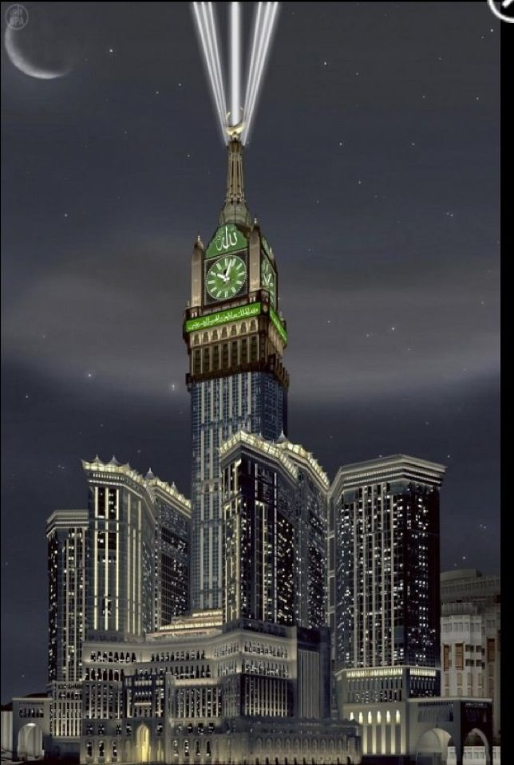

Makkah Royal Tower Clock
City & Country: Mecca, Saudi Arabia
Height: 601 m.
Floors: 120
Completion Year: 2012
Ref: Bhushan Mahajan
Image: Pinterest

Slide 4
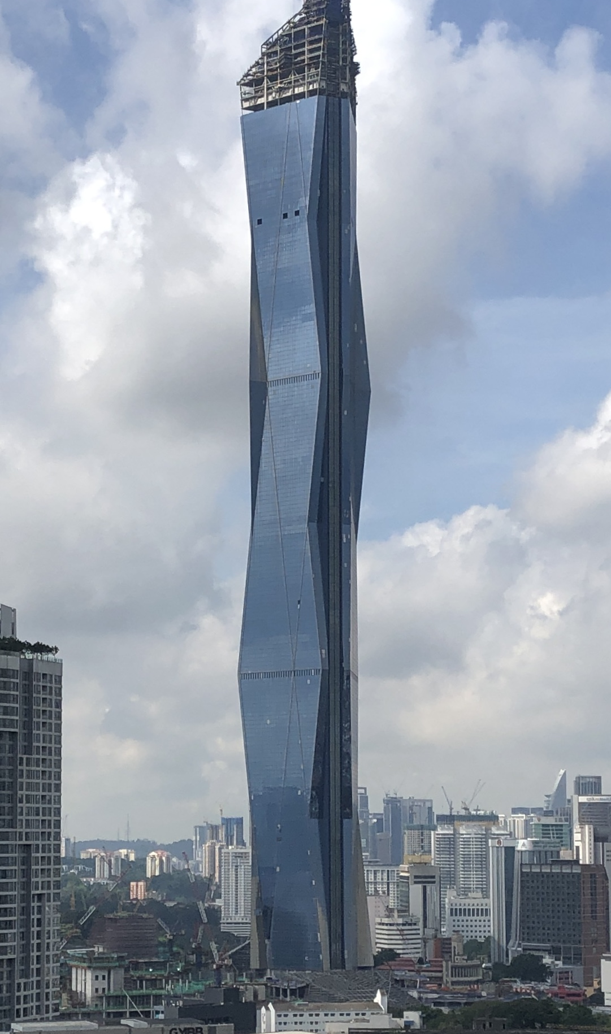

Merdeka PNB118
City & Country: Kuala Lumpur, Malaysia
Height: 630 m.
Floors: 118
Completion Year: 2020
Ref: Bhushan Mahajan
Image: Wikimadia Commons

Slide 5
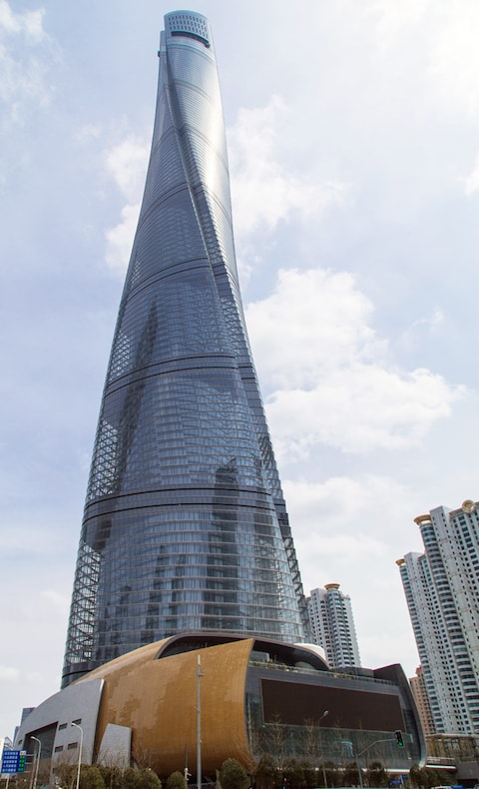

Shanghai Tower
City & Country: shanghai, China
Height: 632 m.
Floors: 128
Completion Year: 2015
Ref: Bhushan Mahajan
Image: The Telegraph

Slide 6
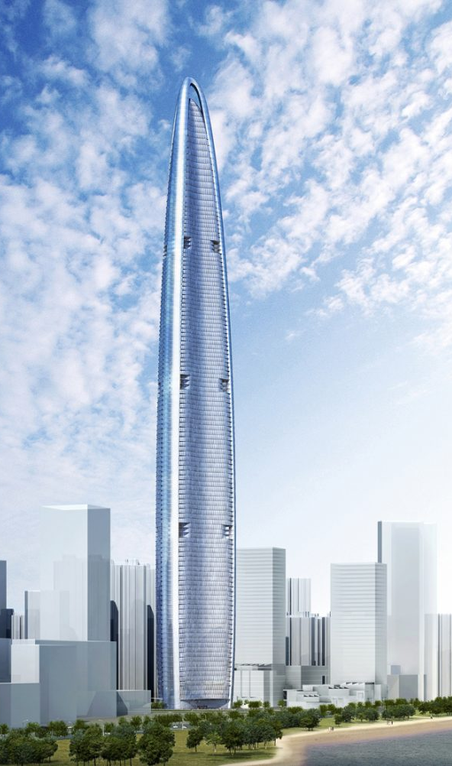

Wuhan Greenland Center
City & Country: Wuhan, China
Height: 636 m.
Floors: 125 q
Completion Year: 2018
Ref: Bhushan Mahajan
Image: Dezeen

Slide 7
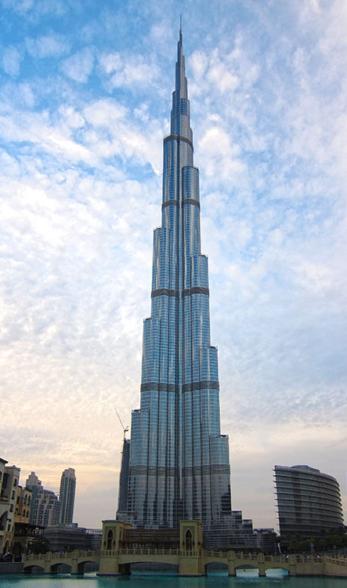

Burj Khalifa
City & Country: Dubai, Arab Emirates
Height: 828 m.
Floors: 163 m.
Completion Year: 2010
Ref: Bhushan Mahajan
Image: Luxe Adventure Traveler

Slide 8
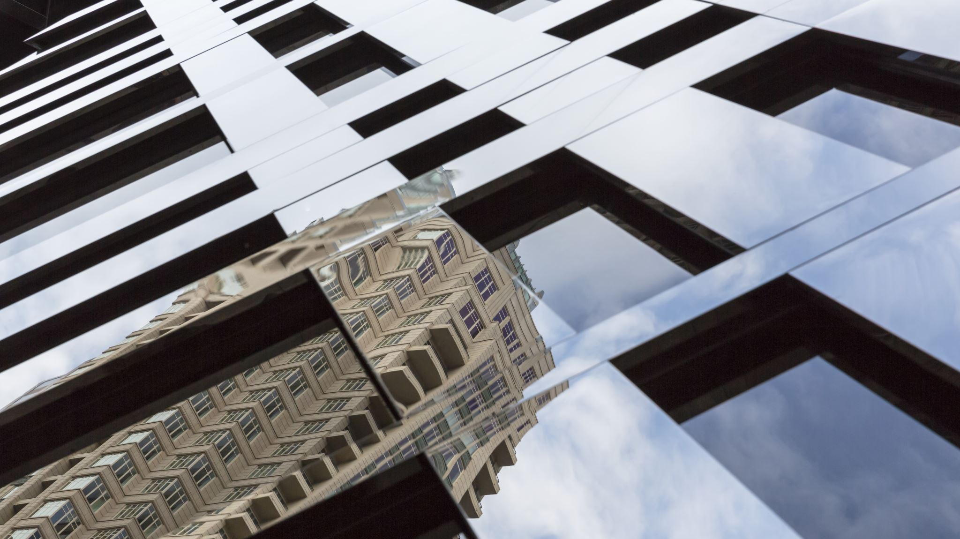
Which Skyscraper Was Your Favourite?
QUESTION
What are your opinions on Skyscraper’s?, are they worth having or not?, and what are the advantages and disadvantages of having them?

Slide 9
Hope You Found My Powerpoint Informative & Enjoyed!
Thanks for watching!...
...Aspha

